Slide 1


NHỮNG NỘI DUNG CẦN CHUẨN BỊ TRƯỚC TIẾT HỌC
UNIT 5: WORK AND PLAY
A1, 2, 4, 5

Slide 2
Hướng dẫn chuẩn bị bài Unit 5 ( A1).
-Các em viết từ mới có trong phần A1 vào tập.
-Đọc đoạn văn phần A1 về Mai sau đó tự đặt 5 câu hỏi về và trả lời.:
What…? / Which school…? / How often…? / Yes/No question ….
Ví dụ: .What is Mai’s favorite class?
-Her favorite class is Computer Science.

Slide 3
New words:
- be interested in (adj): thích, quan tâm
(how) + to-Verb
: học cách làm..
- learn (v)
about sth
: học về..
- experiment (n): thí nghiệm

Slide 4
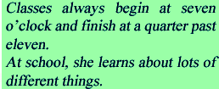


Slide 5



Slide 6
PRACTICE
Ask and answer 5 questions about Mai.
Cues:
1. What’s her favorite subject ?
2.What does Mai learn in Computer Science class?
3. What does Mai study in Physics class?
4. What is her favorite subject?
5. Is Geography easy or difficult?

Slide 7
Hướng dẫn chuẩn bị bài Unit 5 – A2
-Các em viết từ mới có trong bài phần A2 vào tập.
-Đọc đoạn văn phần A2 về Ba. Sau đó trả lời 5 câu hỏi về Ba trang 53 và trả lời 3 câu hỏi về mình ở phần About you.

Slide 8
New words:
- Electronics (n): điện tử
household appliance (n):đồ dùng
gia dụng
- repair (v): sửa chữa
- fix (v): lắp đặt
be good / bad at
( giỏi / dở về…)
+ Noun / V-ing
He is good at fixing things.
He is good at Electronics.
- famous (adj): nổi tiếng

Slide 9
Read the text
Ba goes to Quang Trung School. He is in class 7A and he enjoys school very much. His favorite subject is Electronics. In this class, he learns to repair household appliances. Now Ba can help his mother and father at home. He can fix the lights, the washing machine and the refrigerator. He is good at fixing things.
In his free time, Ba learns to play the guitar. He also goes to his art club after school. His drawings are very good. His teacher says, “Ba, you’ll be a famous artist one day.”

Slide 10
Answer the questions.
a. Which subject does Ba like best?
b. Does Ba like other subjects at school? Write the sentence that tells you this.
c. What does he learn to do in Electronics?
d. How does this subject help Ba?
e. Is Ba good at drawing?
Write the sentence that tells you this.

Slide 11
HƯỚNG DẪN CHUẨN BỊ
UNIT 5 : WORK AND PLAY
SECTION A: In class (A 4,5)
( Trang : 54, 55)
Chuẩn bị cho phần A4/trang 54. Listen.
- Ôn lại tên của các môn học.
- Nhìn tranh đoán tên môn học.
2. Phần A5/ trang 55. Read.
Luyện đọc bài (Read)
Tự dịch sẵn các từ vựng : technology, author, event, essay.
Ôn lại thì hiện tại đơn( Present simple tense)
Chuẩn bị bài viết : Write about the subjects you learn at school.
SÁCH GIÁO KHOA TIẾNG ANH 7-CHƯƠNG TRÌNH CŨ

Slide 12
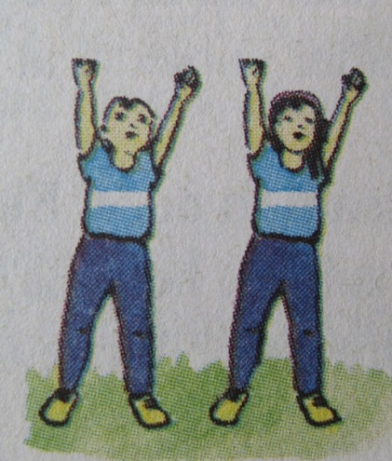
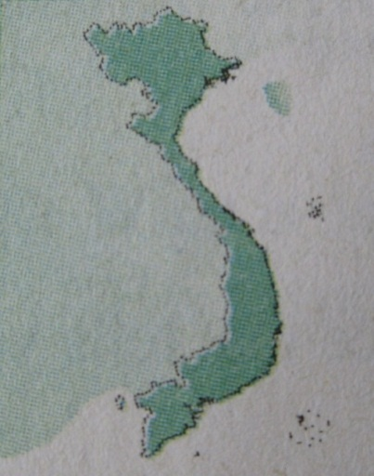
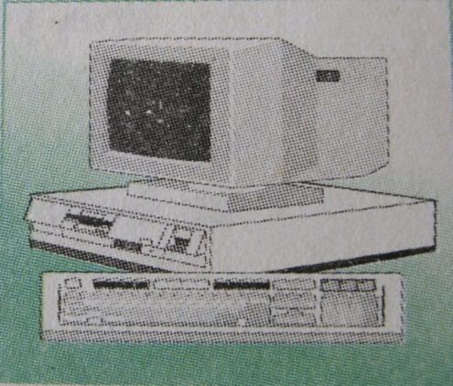
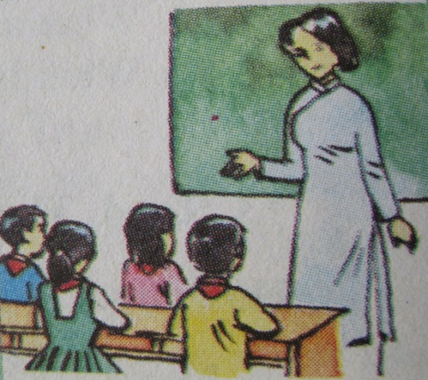
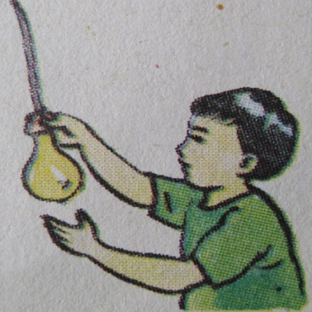
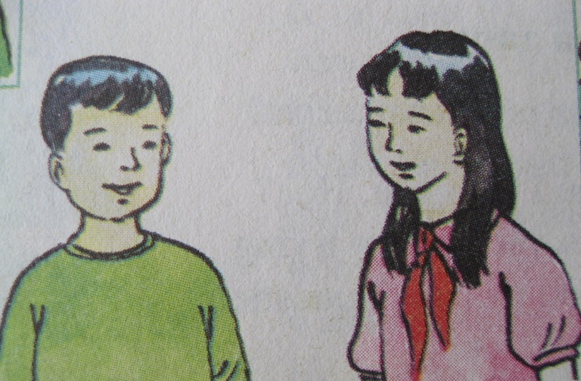
Unit 5
A4. Listen. Then write the correct letters next to the names.
c
b
a
d
e
Ba
Hoa

Slide 13
Unit 5
Work and play
SECTION A:
IN CLASS
A5. Read
I. New words
essay /ˈes.eɪ/ (n): bài luận/ bài văn
event/ɪˈvɛnt/ (n) : Sự kiện
author /ˈɔː.θər/ (n): Tác giả

Slide 14
A5 - Read
At school we study many things. In Literature, we learn about books and write essays. In History, we study past and present events in Viet Nam and around the world. In Geography, we study different countries and their people. In Physics, we learn about how things work. In the Language class, we study English. We study many other things as well, such as Music, Sports and Art. We enjoy all our classes.

Slide 15
SEE YOU SOON!

